Slide 1
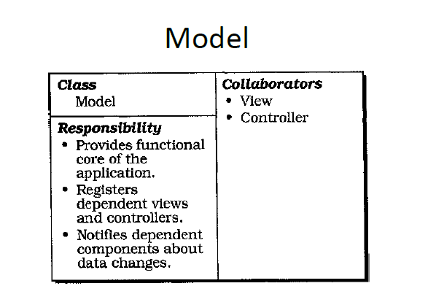

Slide 2
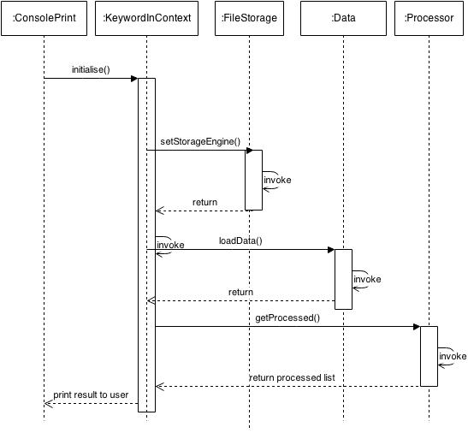
View
Model
Controller

Slide 3
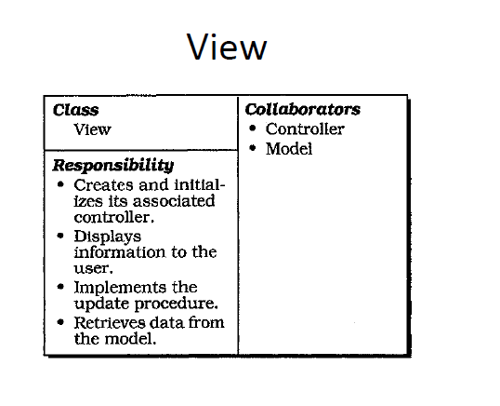

Slide 4
View
Model
Controller

Slide 5
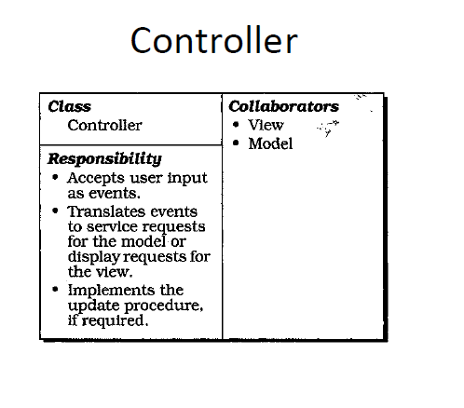

Slide 6
View
Model
Controller

